Slide 1
NTLM…still…in 2023
Advanced Persistent Threats?
OR Admins Pressed for Time
Matthew Navarro
matthewgenenavarro@protonmail.com

Slide 2
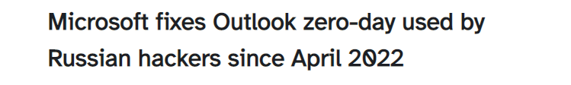
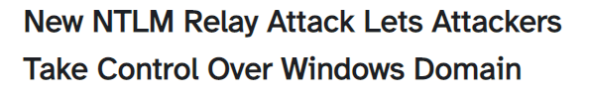
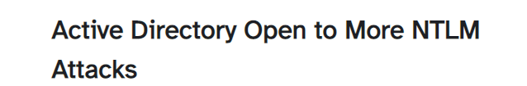
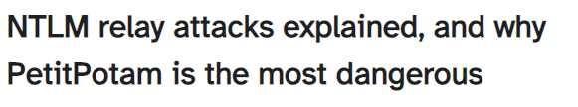
Why do we care?
Notable recent events
CVE that involves Outlook
MS-RPCE abuse
MS-EFSRPC abuse
NTLM Relay to AD CS HTTP Endpoints – ESC8
New to come…

Slide 3
History Lesson
LM 1987
LM Hash 1987 vulnerable to downgrade attacks
NTLMv1 1993 NT 3.1vulnerable to downgrade attacks
NT Hash
NTLMv2 >= 1996 NT 4.0 SP4

Slide 4
Fancy Words
NT Hash/LM Hash – Hash Algorithms
Can be used for Pass-the-Hash
NTLM – Authentication Protocol
NetNTLM/NTLM hash
Cannot be used for Pass-The-Hash
Security Support Provider (SSP) Protocols implement in Modules
Security Support Provider Interface (SSPI)
Notes:
NetNTLM Hashes are NOT NT hashes. An NT hash is used in the process and can be cracked to retrieve the NT Hash or relayed, but its cannot be used for a Pass-The-Hash attack. You would have to find the NT hash used in the NetNTLM hash and then forward that.

Slide 5
NT Hash vs NetNTLM Hash
NT hash Pass-the-Hash
B4B9B02E6F09A9BD760F388B67351E2B
Net-NTLM hash Bruteforce/Relay
admin::N46iSNekpT:08ca45b7d7ea58ee:88dcbe4446168966a153a0064958dac6:5c7830315c7830310000000000000b45c67103d07d7b95acd12ffa11230e0000000052920b85f78d013c31cdb3b92f5d765c783030

Slide 6
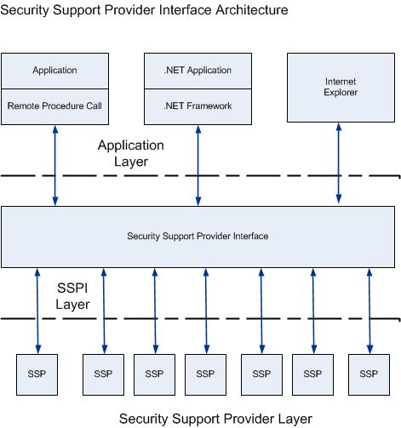
Source:
https://learn.microsoft.com/en-us/windows-server/security/windows-authentication/security-support-provider-interface-architecture

Slide 7
The Moving Pieces
(1) NTLM Negotiate
(2) NTLM Challenge
(3) NTLM Authentication
(4) NETLOGON
(5) Accept/Deny

Slide 8
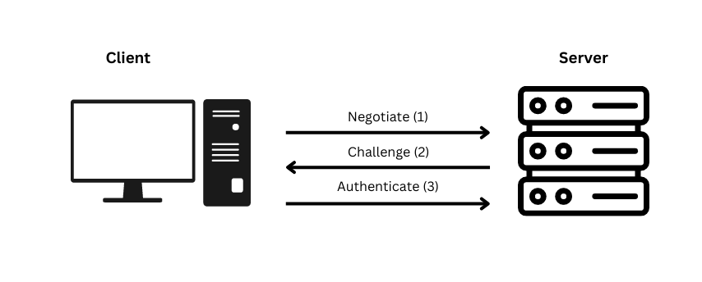
Normal NTLM Traffic w Local Auth

Slide 9
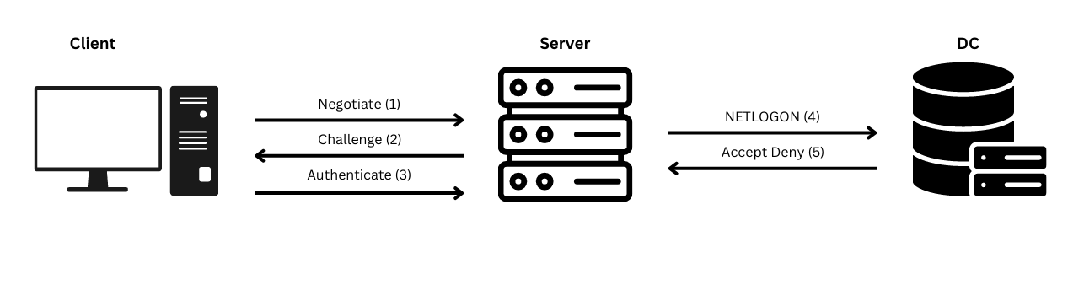
Normal NTLM Traffic w Network Auth

Slide 10
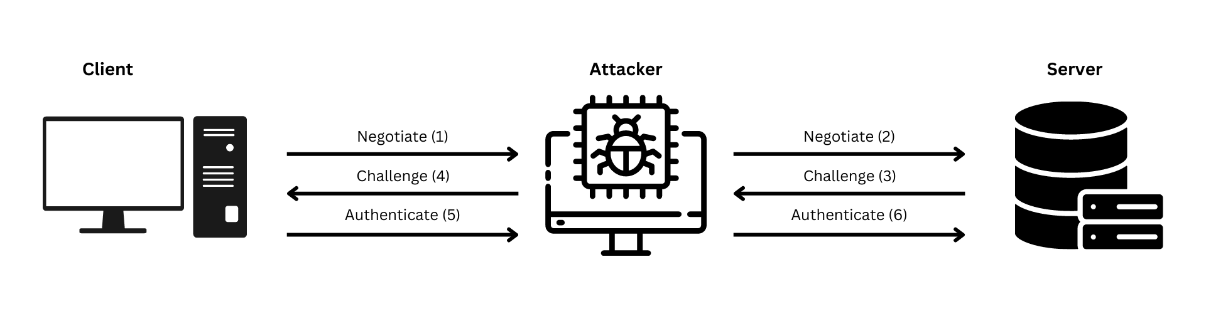
NTLM Relay Traffic

Slide 11
NTLM Relays
SMB Relay CVE-1999-0504 1st Relay attack
HTTP Relay 2004 but no PoC/2007 HD Moore – Metasploit module
LDAP Relay CVE-2017-8563
RDP Relay CVE-2018-0886
Exchange Relay CVE-2021-28480

Slide 12
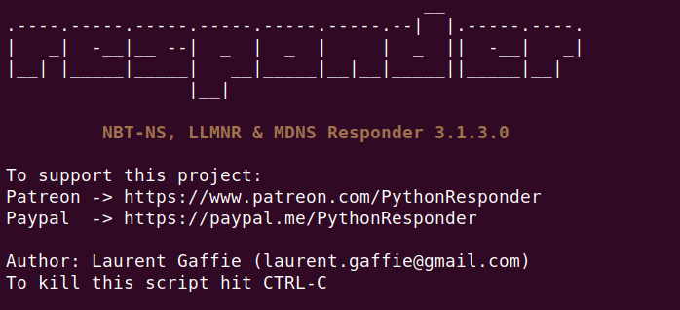
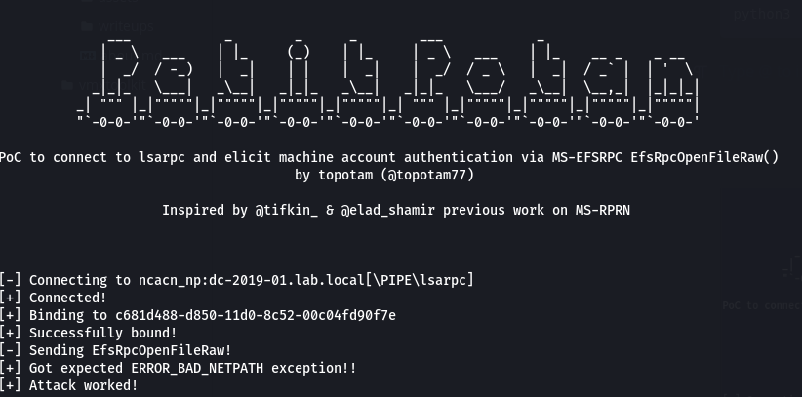
Types of NTLM Relay’s
Basic Protocol Relay
SMB
HTTP
LDAP
Poisoning Attacks
LLMNR
mDNS
mim6
Coercion Authentication Attacks
Printerbug MS-RPRN 2017
PetitPotam MS-EFSRPC 2021
ShadowCoerce MS-FSRVP 2021-2022
DFSCoerce MS-DFSNM 2022
CheeseOunce MS-EVEN 2022

Slide 13
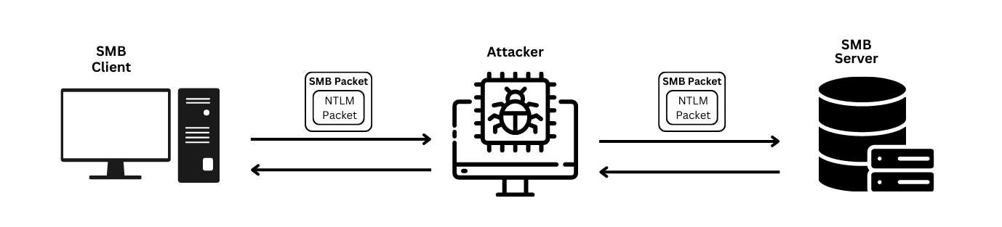
Protocol Relay Traffic

Slide 14
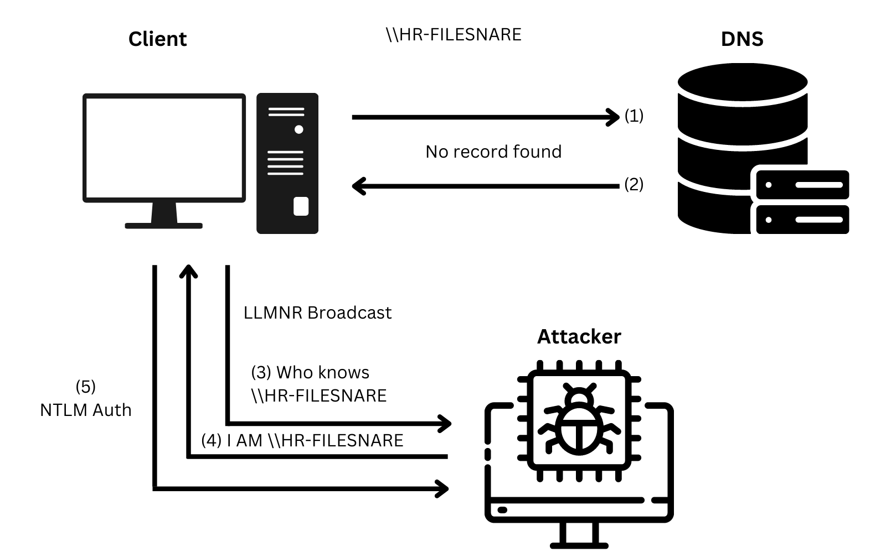
LLMNR Poisoning

Slide 15
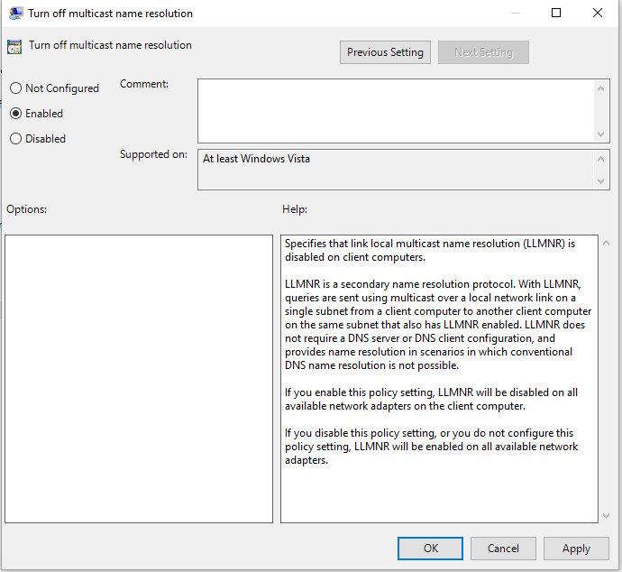
Poisoning Mitigations
Turn off Link Layer Multicast Name Resolution
Computer Configuration -> Administrative Templates -> Network -> DNS ClientEnable Turn Off Multicast Name Resolution: Enabled
Disable IPv6
Identify old logon scripts with responder -A

Slide 16
NTLM Coercion
Remote Procedure Calls!!! Modern NTLM abuse
Petitpotam testing
Petitpotam.py
August 10, 2021 patch
PrinterBug testing
Printerbug.py
Mitigations?
Consider disabling printer spooler
Patch!!
Keep on eye on the cybersec community

Slide 17
NTLM Relay Mitigations
$Path = Computer Configuration > Policies > Windows Settings > Security Settings > Local Policies > Security Options
Enable SMB Signing: Microsoft network server/client
Client (always)
Server (always)
Enable LDAPS Signing Domain controller: LDAP server signing requirements
Enable EAP
AUDIT AUDIT AUDIT!!!
Notes:
UNC Hardening
Enable LDAP signing
Enable LDAP channel binding

Slide 18
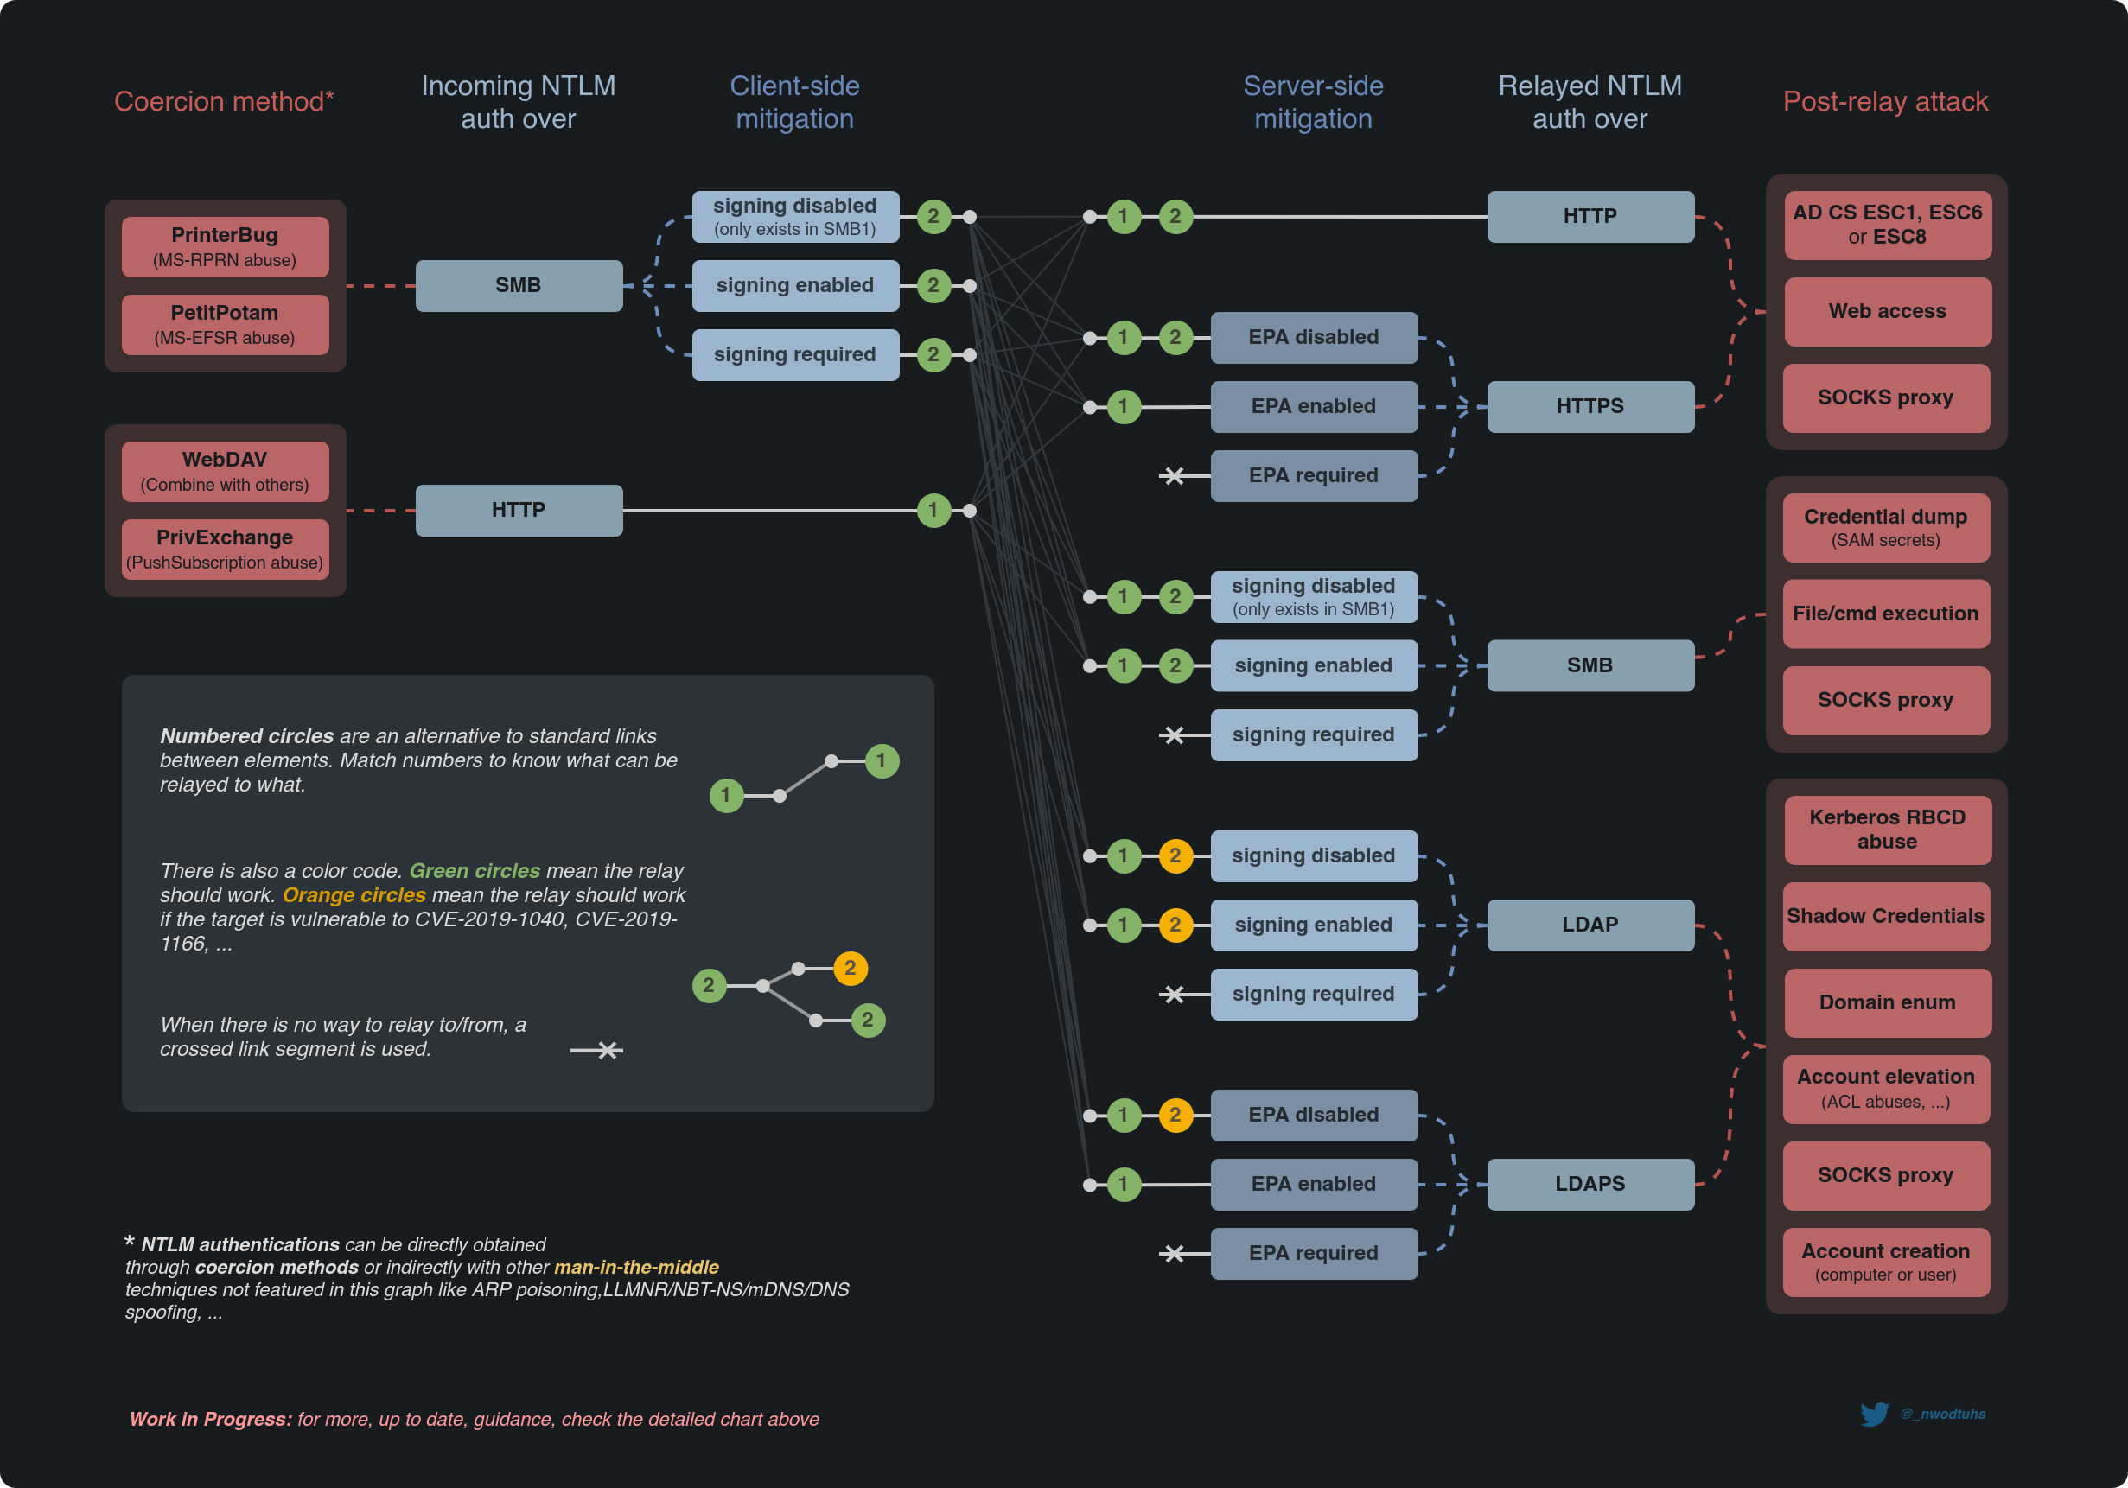
Source:
https://www.thehacker.recipes/ad/movement/ntlm/relay

Slide 19
Hunting NTLM traffic
Domain Controller => Event ID 8004
Member Server => Event ID 8003
Client => Event ID 8001
Enable NTLM auditing
All client and servers
Domain Controllers

Slide 20
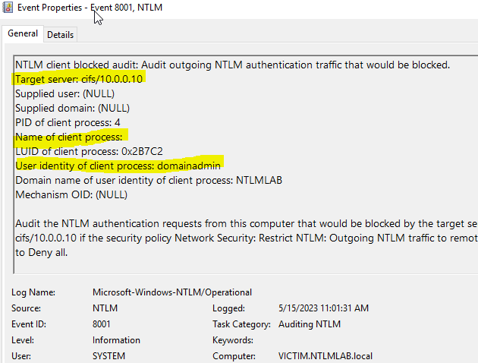
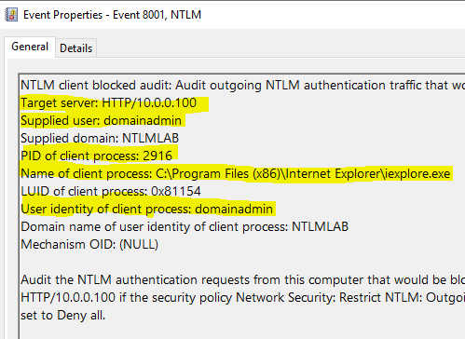
Hunting NTLM traffic ID 8001

Slide 21
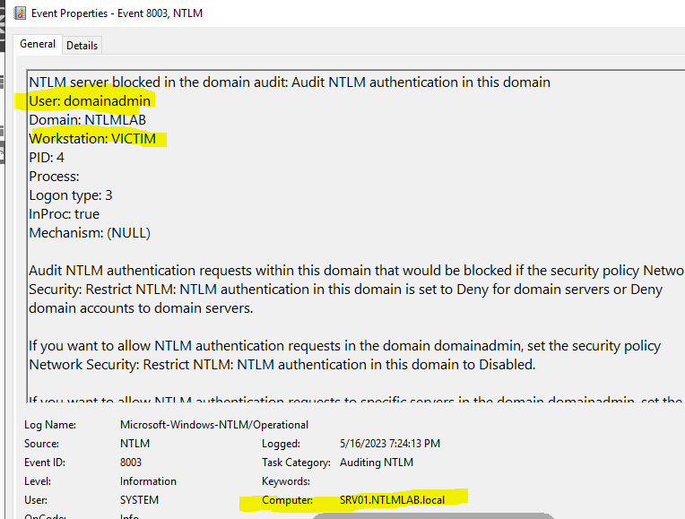
Hunting NTLM traffic ID 8003

Slide 22
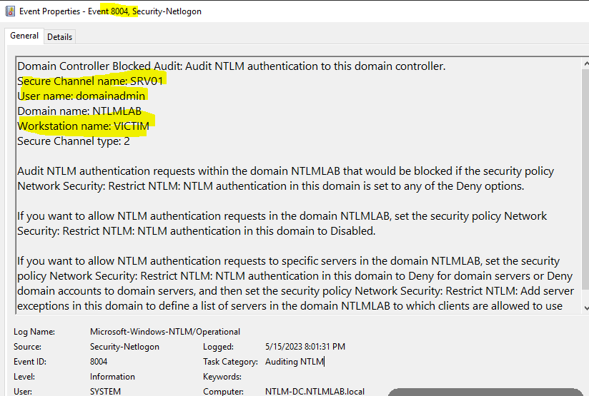
Hunting NTLM traffic ID 8004

Slide 23
Questions?

Slide 24
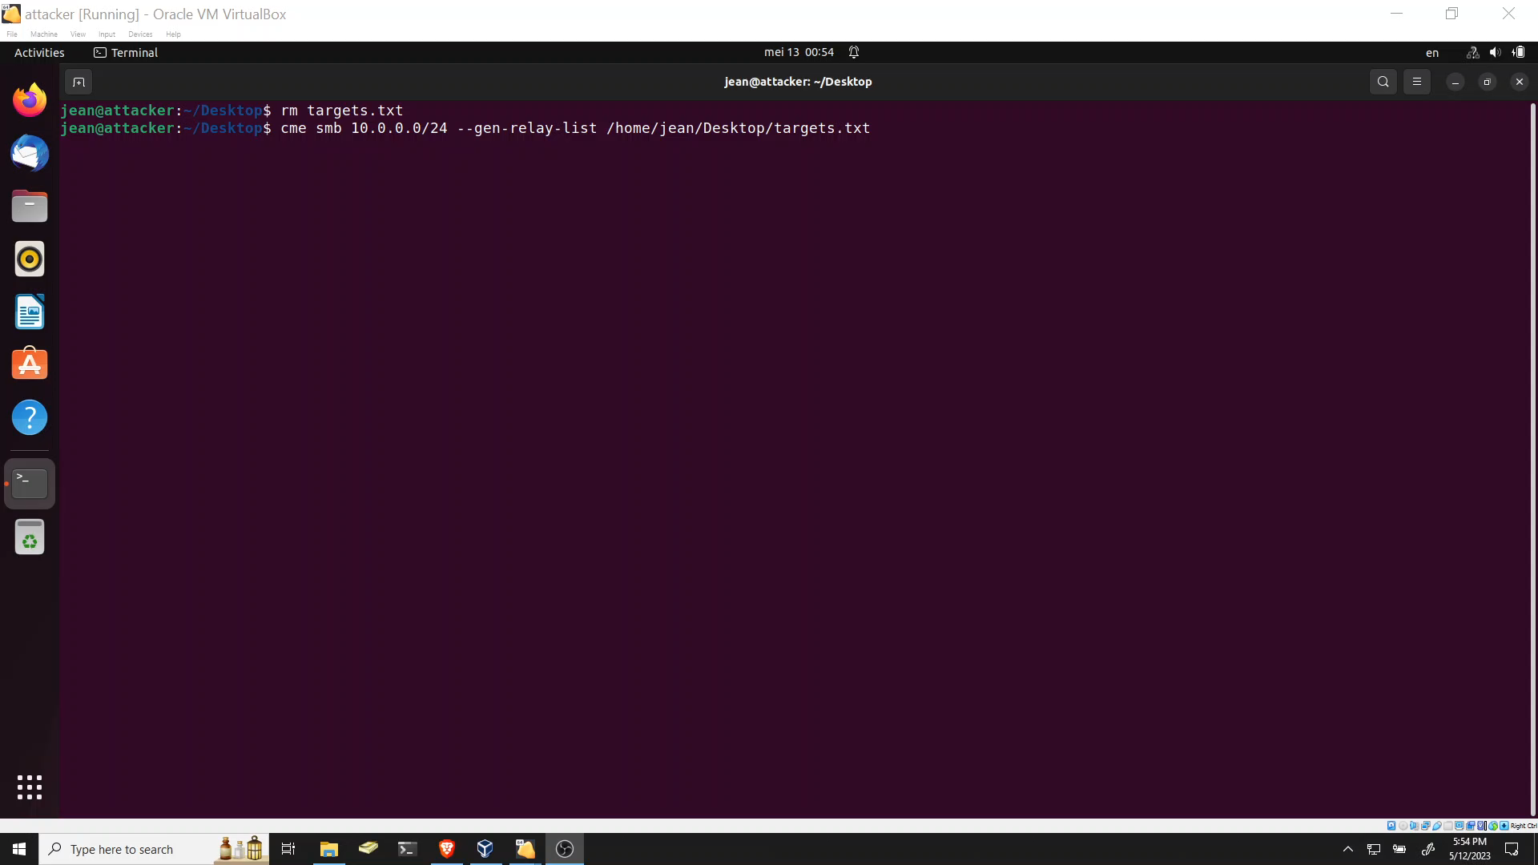

Slide 25
